Slide 1
AI VS. HUMAN : ACADEMIC ESSAY AUTHENTICITY CHALLENGE
PIP2001 Capstone Project
Review-0
Batch Number:PSCS180
Under the Supervision of,
Prof. Sandhya L
Assistant Professor
School of Computer Science and Engineering
Presidency University
STUDENT NAMES | ROLL NUMBER
MANJUNATH REDDY | 20211CST0043
MALLIKA | 20211CST0002
HARI NARAYANA | 20211CST0029
RAKSHITHA M | 20211CST0050
Roll Number | Student Name
Name of the Program:
Name of the HoD: Dr.Saira bhanu
Name of the Program Project Coordinator: Dr.H M Manjula
Name of the School Project Coordinators: Dr. Sampath A K / Dr. Abdul Khadar A / Mr. Md Ziaur Rahman

Slide 2
Content
Problem Statement
Analysis of Problem Statement
Timeline of the Project
References

Slide 3
Problem Statement Number: PSCS193
Organization: AI vs. Human: Academic Essay Authenticity Challenge
Category (Hardware / Software / Both) : Software
Problem Description: The objective is to identify machine-generated essays to safeguard academic integrity and prevent the misuse of large language models in educational settings. The input to the system would be essays including texts authored by both native and non-native speakers, as well as essays generated by various large language models. The task is defined as follows: "Given an essay, identify whether it is generated by a machine or authored by a human." This is a binary classification task and is offered in English and Arabic. Further information: https://gitlab.com/genai-content-detection/genai-content-detection-coling-2025
Difficulty Level:Complex / Medium

Slide 4
Analysis of Problem Statement
Technology Stack Components: Full stack Web Dev
Frontend:
React.js
HTML & CSS
JavaScript
Chart.js
Backend:
Node.js
Python/Django
Database
MongoDB (NoSQL)
MySQL (SQL)

Slide 5
Analysis of Problem Statement (contd...)
Software and Hardware Requirements:
Operating System: Windows 10, macOS, Linux
Frameworks: React.js, Node.js,, Django, Flask
Database: MongoDB, MySQL
Version Control: Git
Web Hosting: AWS/ Firebase

Slide 6
Analysis of Problem Statement (contd...)
Functionalities:
Essay Classification:The system will analyze essays and classify them as either machine-generated or human-authored using a robust binary classification model.
Detection of Large Language Model Output:It will specifically detect essays generated by large language models, ensuring that content created by AI systems is accurately identified.
User-Friendly Interface:A simple and intuitive interface will allow users (educators, administrators, etc.) to upload essays and view results regarding whether the essay is machine-generated or human-authored.

Slide 7
Analysis of Problem Statement (contd...)
Real-Time Feedback:The system will provide quick results, enabling educators to immediately assess the authenticity of submitted essays and take appropriate actions.
Performance Analytics:The system will maintain performance metrics to continually improve its accuracy and handle variations in essay writing styles from diverse sources.

Slide 8
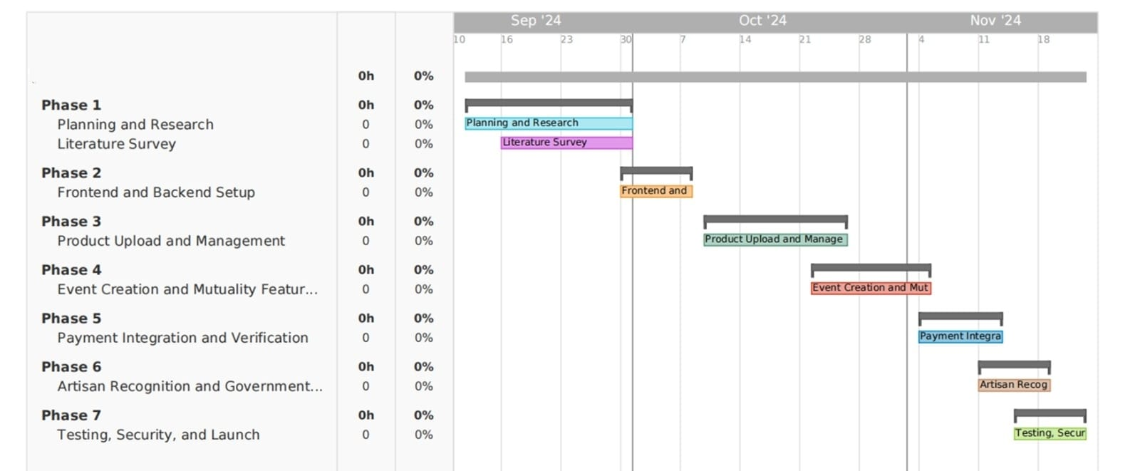
Timeline of the Project (Gantt Chart)

Slide 9
References (IEEE Paper format)
[1] R. Corizzo and S. Leal-Arenas, "A Deep Fusion Model for Human vs. Machine-
Generated Essay Classification," IEEE, 2023.
[2] W. H. Pan, M. J. Chok, J. L. S. Wong, Y. X. Shin, Z. Yang, Y. S. Poon, C. Y.
Chong, D. Lo, and M. K. Lim, "Assessing AI Detectors in Identifying AIGenerated
Code: Implications for Education," IEEE, 2024.

Slide 10
[3] V. Pandita, A. M. Mujawar, T. Norbu, V. Verma, and P. Patil, "Text Origin
Detection: Unmasking the Source – AI vs Human," IEEE , 2024.
[4] D. Yan, M. Fauss, J. Hao, and W. Cui, "Detection of AI-generated Essays in
Writing Assessments," Psychological Test and Assessment Modeling, vol. 65,
2023.
[5] X. Peng, Y. Zhou, B. He, L. Sun, and Y. Sun, "Hiding the Ghostwriters: An
Adversarial Evaluation of AI-Generated Student Essay Detection,"
arXiv:2402.00412v1 [cs.CL], Feb. 2024.

Slide 11


